Slide 1

HERAF: Empowering Handcraft Creators in Egypt
Team Members: 1. Hussein Osama 2.Hessein Mostafa
3.Osama Sameh
4.Madonna Nageh
5.Omnia Abu-Elhassan

Slide 2
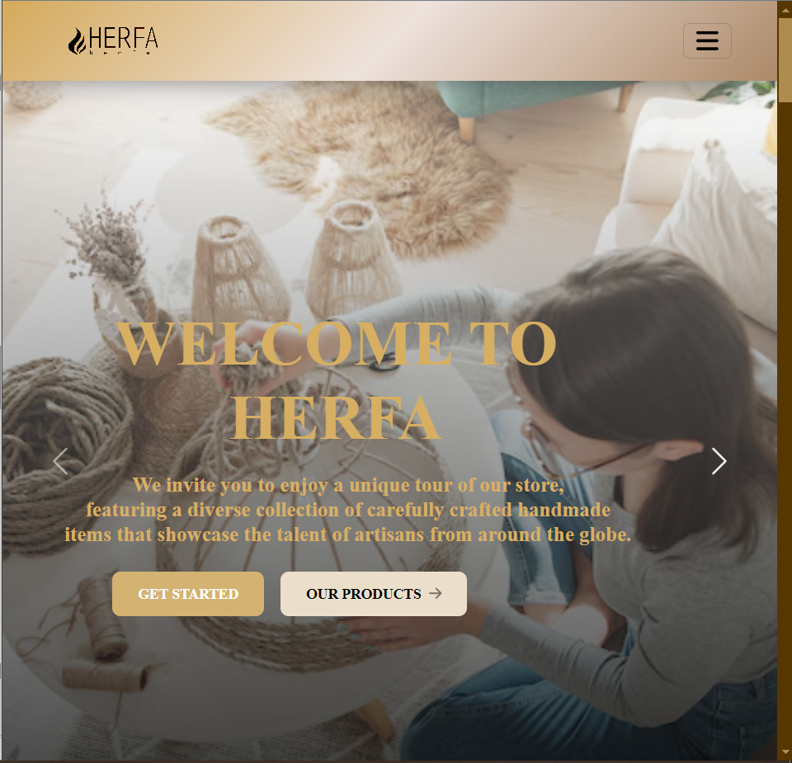
Overview of the Project
HERAF is a web-based platform designed for artisans and crafters in Egypt to showcase and sell their handmade products.
Built using Angular, TypeScript, and Firebase to ensure a seamless user experience.
Focuses on connecting sellers with buyers, simplifying the process of buying and selling handmade goods.

Slide 3

The Challenges of Selling Handmade Products in Egypt
1
Limited Reach
2
Complex Logistics
Handcraft creators often struggle to find customers beyond their local community, limiting their growth potential.
The logistics of inventory management, shipping, and payments can be daunting for individual artisans.
3
Lack of Visibility
Without a centralized platform, handcraft creators face difficulties in showcasing their products and building brand recognition.

Slide 4
Motivation for the Project
Personal Motivation:
Market Potential:
A passion for supporting local artisans and promoting handmade crafts.
A desire to contribute to the Egyptian economy by empowering small businesses and individual crafters.
Growing interest in handmade products and a rising trend for online shopping, especially in the wake of recent global events.
Opportunity to fill a gap in the market by providing a dedicated platform for artisans and craft enthusiasts.
Objectives and Goals
Main Objectives:
To create a user-friendly platform that allows artisans to list and manage their handmade products easily.
To provide buyers with a simple and enjoyable shopping experience for handmade items.
Goals:
Enable secure user registration and authentication through Firebase.
Allow sellers to upload product details, including images, descriptions, and pricing.
Facilitate a streamlined order placement process for customers.
Implement real-time notifications for order updates and communications.

Slide 5
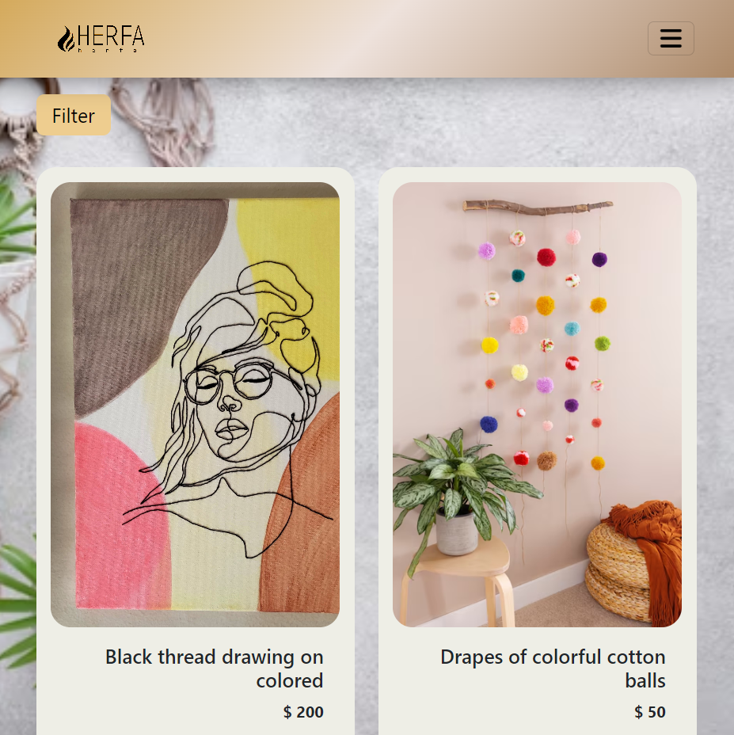
Literature Review / Market Research
Previous Research
Global platforms (e.g., Amazon, Etsy) connect buyers and sellers but lack focus on handmade crafts in Egypt.
Localized niche platforms improve user engagement and trust.
Digital transformation boosts small businesses by enhancing market access.
Existing Products / Competitor Analysis
HERAF has many competitors like Etsy, Facebook Marketplace, Amazon Handmade, and Jumia Egypt

Slide 6

The Technology Behind HERAF: Angular and TypeScript
Angular Framework
Modular Architecture
HERAF leverages the power of the Angular framework to build a responsive and dynamic web application.
The application is designed with a modular architecture, allowing for scalability and easy integration of new features.
1
2
3
TypeScript Adoption
The HERAF team has embraced TypeScript, a superset of JavaScript, to enhance code maintainability and developer productivity.

Slide 7




Integrating Firebase for Seamless Transactions
Secure Authentication
Scalable Database
Seamless Hosting
Firebase Authentication ensures a trusted and secure login experience for HERAF users.
The Firebase Realtime Database provides a highly scalable and reliable backend for HERAF.
Firebase Hosting enables efficient deployment and fast delivery of the HERAF platform.

Slide 8
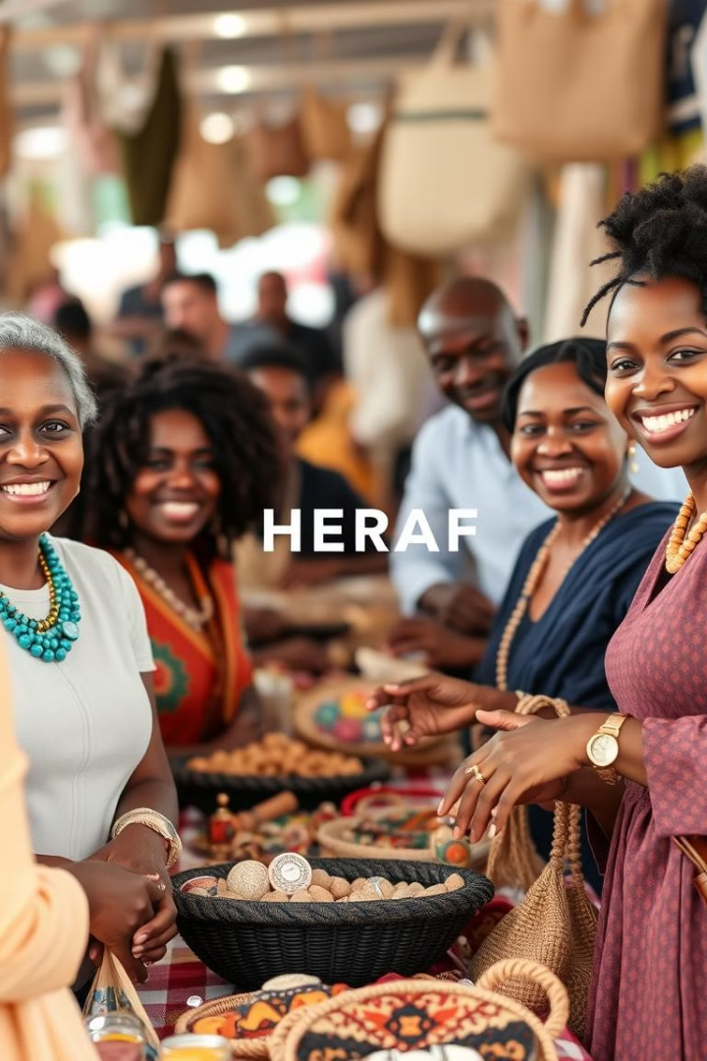
The Benefits of HERAF for Handcraft Creators
1
Methodology
2
Milestones and Timeline
Agile Methodology:
1. Iterative development with continuous feedback. 2. Regular sprints to deliver features incrementally.
Month 1: Project planning, requirements gathering, and design.
Month 2: Frontend and backend development.
Month 3: Firebase integration, testing, and debugging.
3
Tools Used in Development
Angular and TypeScript were used for frontend development, Firebase for backend services (authentication, database, hosting), GitHub for version control, Postman for API testing, and VS Code as the code editor.

Slide 9
Implementation
System Demonstration
User Authentication: Secure login/registration via Firebase.
Product Management: Sellers can add, edit, and delete products with photos and details.
Order Management: Customers can browse products, add them to the cart, and place orders.
Major Features Explained
Authentication: Firebase ensures secure user login and data protection.
Product Management: Simplifies uploading and organizing products by sellers.
Order Placement: Provides a smooth shopping experience with cart functionality.

Slide 10
Challenges and Solutions
1
Challenges Encountered
2
Solutions Implemented
Authentication Complexity: Managing secure login and session handling.
Real-Time Data Sync: Ensuring smooth updates across users.
Responsive Design: Adapting the UI across different devices and screen sizes.
Firebase Authentication: Simplified secure user management.
Optimized Firebase Queries: Improved data sync for orders and notifications.
CSS Media Queries & Flexbox: Ensured consistent UI across devices.
Lessons Learned
3
Importance of modular code for easier debugging and maintenance.
Early user feedback helps detect usability issues.
Real-time features require efficient backend optimization.

Slide 11
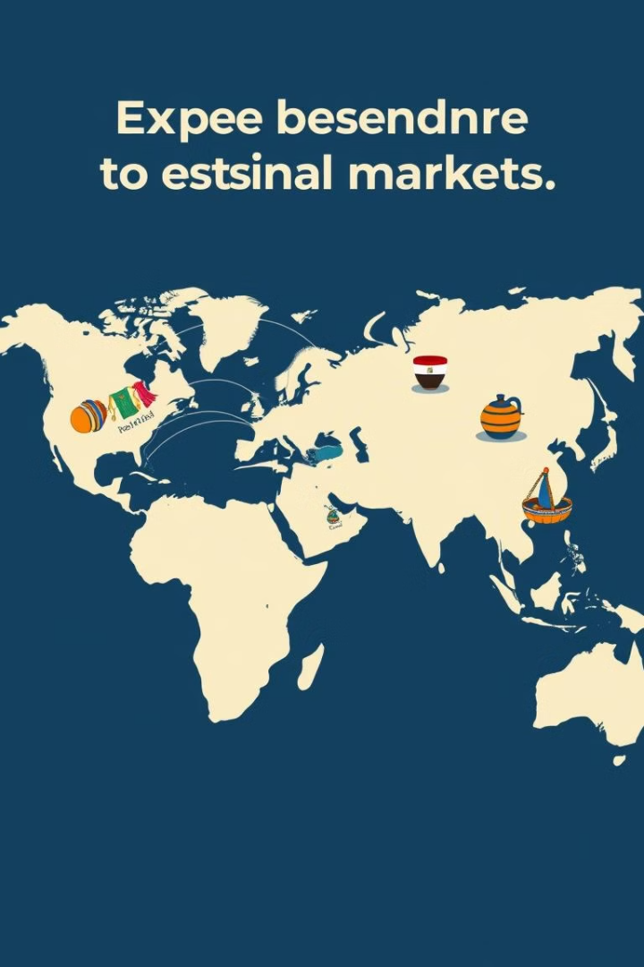



The Future of HERAF And Improvements :
Future Enhancements
Mobile App Development: Build a native app for Android and iOS.
Advanced Search Filters: Add filtering by location, ratings, and availability.
Payment Integration: Enable online payments for smoother transactions.
Areas for Expansion
International Market: Expand platform to serve neighboring countries.
Community Features: Introduce forums and user groups for artisans.
Analytics Dashboard: Provide sellers with insights on sales and customer behavior.
Gather user feedback to refine features.
Conduct beta testing with a small group of users.
Begin marketing campaigns to onboard sellers and buyers
Next Steps

Slide 12
Conclusion
1
Summary of Achievements
Successfully developed a user-friendly platform for buying and selling handmade crafts.
Integrated Firebase for secure authentication and real-time updates.
Implemented responsive design, ensuring accessibility across devices.
2
Reflection on Impact
Enhanced market access for artisans, fostering local craftsmanship.
Improved customer experience with a streamlined purchasing process.
Contributed to the digital transformation of small businesses in Egypt.
3
Final Remarks
Looking forward to future enhancements and broader market reach.
Excited about the potential for community engagement and support.
Thank you for your attention, and I welcome any questions!

Slide 13


